Slide 1
SpringBoot Security

Slide 2
Default Security SetUp
<dependency>
<groupId>org.springframework.boot</groupId>
<artifactId>spring-boot-starter-security</artifactId>
</dependency>
a default password is randomly generated and printed in the console log:
Using default security password: c8be15de-4488-4490-9dc6-fab3f91435c6
Username is user

Slide 3
In application.properties username and password can be set.
spring.security.user.name
spring.security.user.password
Disables the auto configuration
@SpringBootApplication(exclude = { SecurityAutoConfiguration.class })
public class SpringBootSecurityApplication {
public static void main(String[] args) {
SpringApplication.run(SpringBootSecurityApplication.class, args);
}
}
spring.autoconfigure.exclude=org.springframework.boot.autoconfigure.security.SecurityAutoConfiguration

Slide 4
Userdefined credentials can be set in application.properties.
spring.security.user.name=user1
spring.security.user.password=password

Slide 5
@Configuration
@EnableWebSecurity
public class MySecurityConfiguration extends WebSecurityConfigurerAdapter{
@Override
public void configure(HttpSecurity httpSecurity) throws Exception
{
httpSecurity
.authorizeRequests()
.anyRequest()
.authenticated()
.and()
.formLogin();
}
}
Authenticates for any url and for any use with form based authentication.

Slide 6
@Override
public void configure(HttpSecurity httpSecurity) throws Exception
{
httpSecurity
.authorizeRequests()
.antMatchers("/hello/user")
.hasRole("USER")
.antMatchers("/hello/admin")
.hasRole("ADMIN")
.anyRequest()
.authenticated()
.and()
.formLogin();
httpSecurity.csrf().disable();
}
@Override
public void configure(AuthenticationManagerBuilder auth) throws Exception
{
auth
.inMemoryAuthentication()
.withUser("user1")
.password("{noop}user1")
.roles("USER")
.and()
.withUser("admin")
.password("{noop}admin")
.roles("ADMIN");
}

Slide 7
//Example 2
public void configure(HttpSecurity httpSecurity) throws Exception
{
httpSecurity
.authorizeRequests()
.antMatchers("/hello/user")
.hasAnyRole("USER","ADMIN")
.antMatchers("/hello/admin")
.hasRole("ADMIN")
.anyRequest()
.authenticated()
.and()
.formLogin();
httpSecurity.csrf().disable();
}

Slide 8
Authentication using Jdbc (h2 database)
@Autowired
private DataSource dataSource; //jdbc:h2:mem:testdb
@Override
public void configure(AuthenticationManagerBuilder auth) throws Exception
{
auth
.jdbcAuthentication()
.dataSource(dataSource)
.withDefaultSchema()
.withUser(
User.withUsername("user2")
.password("{noop}user2")
.roles("USER")
)
.withUser(User.withUsername("admin1")
.password("{noop}admin1")
.roles("ADMIN"));
}
<dependency>
<groupId>com.h2database</groupId>
<artifactId>h2</artifactId>
<scope>runtime</scope>
</dependency>
<dependency>
<groupId>org.springframework.boot</groupId>
<artifactId>spring-boot-starter-jdbc</artifactId>
</dependency>

Slide 9
Using MySql db and user defined schema.
//create schema.sql with the following code
CREATE TABLE users (
username VARCHAR(50) NOT NULL,
password VARCHAR(100) NOT NULL,
enabled TINYINT NOT NULL DEFAULT 1,
PRIMARY KEY (username)
);
CREATE TABLE authorities (
username VARCHAR(50) NOT NULL,
authority VARCHAR(50) NOT NULL,
FOREIGN KEY (username) REFERENCES users(username)
);
CREATE UNIQUE INDEX ix_auth_username
on authorities (username,authority);

Slide 10
Method Level Security
@Controller
public class Securitycontroller {
@PreAuthorize("hasRole('ROLE_ADMIN')")
@GetMapping("/access")
@ResponseBody
public String getAccess()
{
return "Restricted method";
}
@PreAuthorize("hasRole('ROLE_USER')")
@GetMapping("/home")
@ResponseBody
public String getAccessUser()
{
return "Home method";
}
}

Slide 11
OAuth (Open Authorization) is an open standard for token-based authentication and authorization on the Internet.
OAuth, which is pronounced "oh-auth," allows an end user's account information to be used by third-party services, such as Facebook, without exposing the user's password. OAuth acts as an intermediary on behalf of the end user, providing the service with an access token that authorizes specific account information to be shared. The process for obtaining the token is called a flow.
OAuth doesn’t share password data but instead uses authorization tokens to prove an identity between consumers and service providers. OAuth is an authentication protocol that allows you to approve one application interacting with another on your behalf without giving away your password.

Slide 12
JWt – Json Web token
JSON Web Token (JWT) is an open standard (RFC 7519) that defines a compact and self-contained way for securely transmitting information between parties as a JSON object. This information can be verified and trusted because it is digitally signed. JWTs can be signed using a secret (with the HMAC algorithm) or a public/private key pair using RSA or ECDSA.

Slide 13
Spring App (Server app)
Request – login
(sends username & password
authenticate/api
Request -browse
(sends username & password
browse/api
buy/api
Request -buy
(sends username & password

Slide 14
Browser
Spring App (Server app)
Request – login
(sends username & password
authenticate/api
Token
Request -browse
(sends JWT token)
browse/api
Token
buy/api
Request -buy
(sends username & password
Token

Slide 15
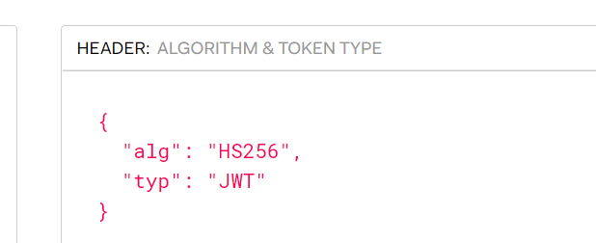
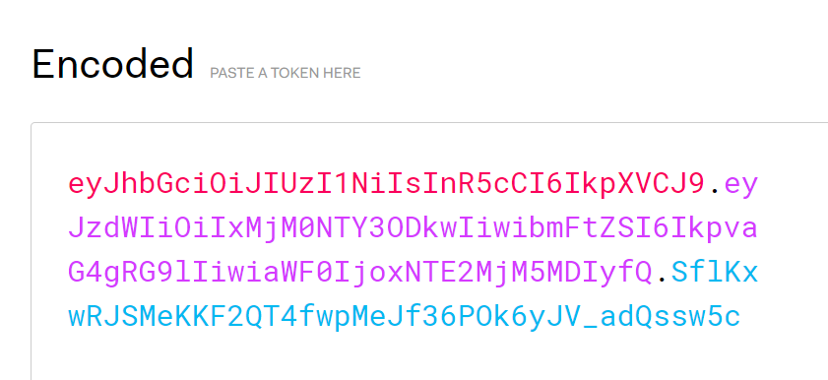
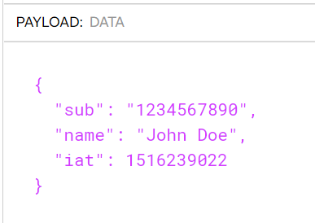
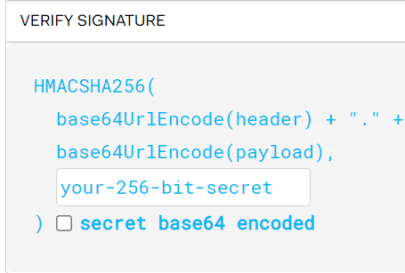

Slide 16
JwtAuthDemoApplication

